Slide 1
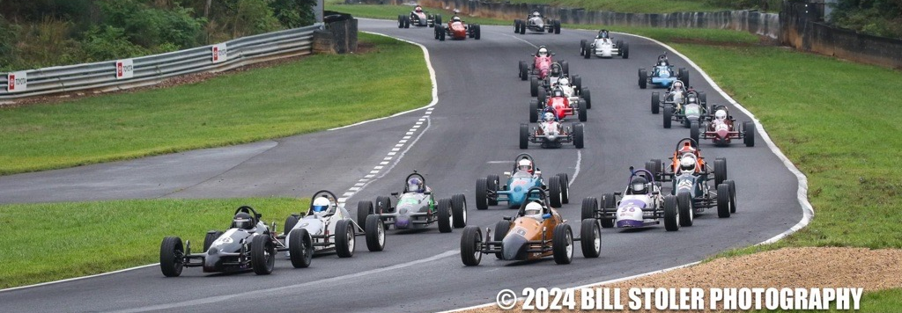
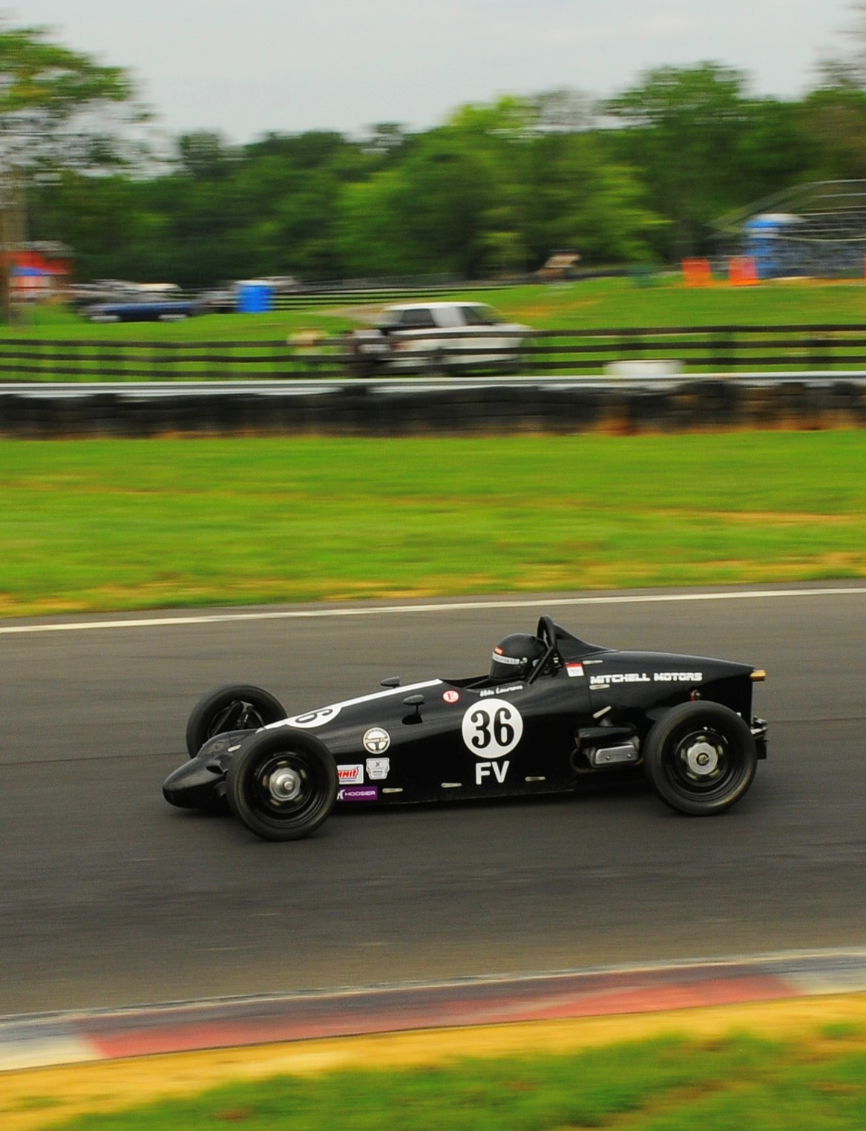
2025 Driverz Cup Sponsor Info
Who we are:
Sponsorship Opportunities:
Driverz Cup is a Formula Vee road racing series focused on camaraderie, competition, and growing formula vee racing in the USA.
The Driverz Cup series draws competitors in for a 5 race weekend series hosted throughout the year at various Southeast tracks in the USA. Championship points are awarded at each event for series members with the champion being crowned each year at our popular Road Atlanta event.
Driverz Cup follows current SCCA FV GCR rules and regulations apart from a 1,075lbs racing weight and the use of Yokohama Advan A052 radial tires rather than Hoosier slicks. The same as seen in iRacing!
Giveaways:
At each Driverz Cup event multiple giveaway items are awarded to members by random selection (e.g. discounts, gift certificates, safety gear, FV parts, and more!
All other monetary sponsors even title sponsors are welcomed
We are looking to add sponsors to assist with these items mentioned and to spread your company's brand!
Why Sponsor the Driverz Cup?
Company recognition to 100+ members per event of the racing community
Business logo displayed on shirts, sweatshirts, banners and more
Recognition on social media
Social Media:
DriverzCup.com
Driverz.cup
Driverz Cup Formula Vee Series
Driverz Cup
2025 Schedule:
February 8-9: Roebling Road
March 22-23: Carolina Motorsports Park
August 15-17 – FV Radial National Championship - Summit Point Motorsports Park
September 13-14: Roebling Road Raceway
November 8-9: Road Atlanta
Contact Driverz Cup:
724-678-1866
Info@driverzcup.com

